Slide 1
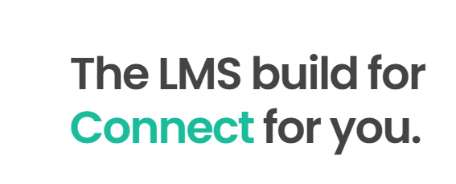
The LMS built to help users Acquire. Apply. Achieve.

Slide 2
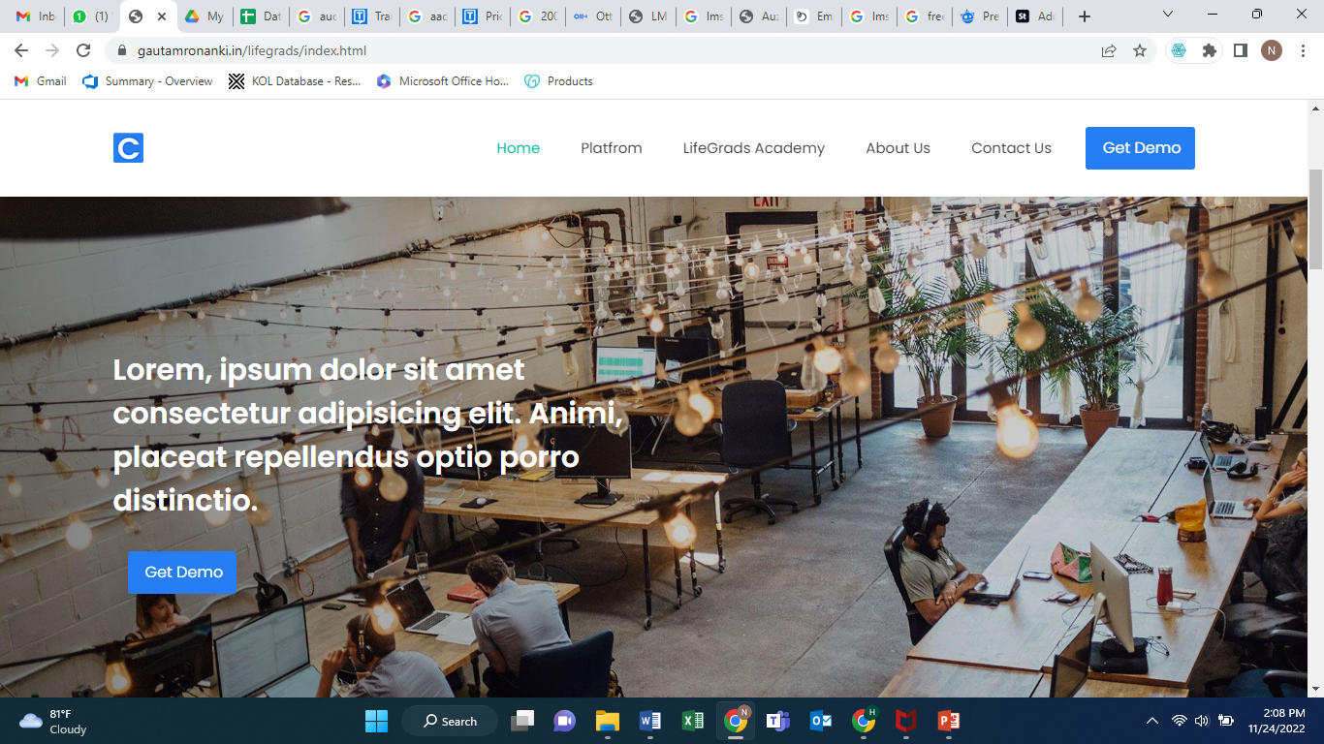
Take the Pic from: https://www.freepik.com/premium-photo/close-up-businessman-hand-holding-lms-learning-management-system-web-icon-lesson-online-education-course-application-study-e-learning-knowledge-everywhere-every-time_23167660.htm#page=4&query=lms&position=28&from_view=search&track=sph

Slide 3
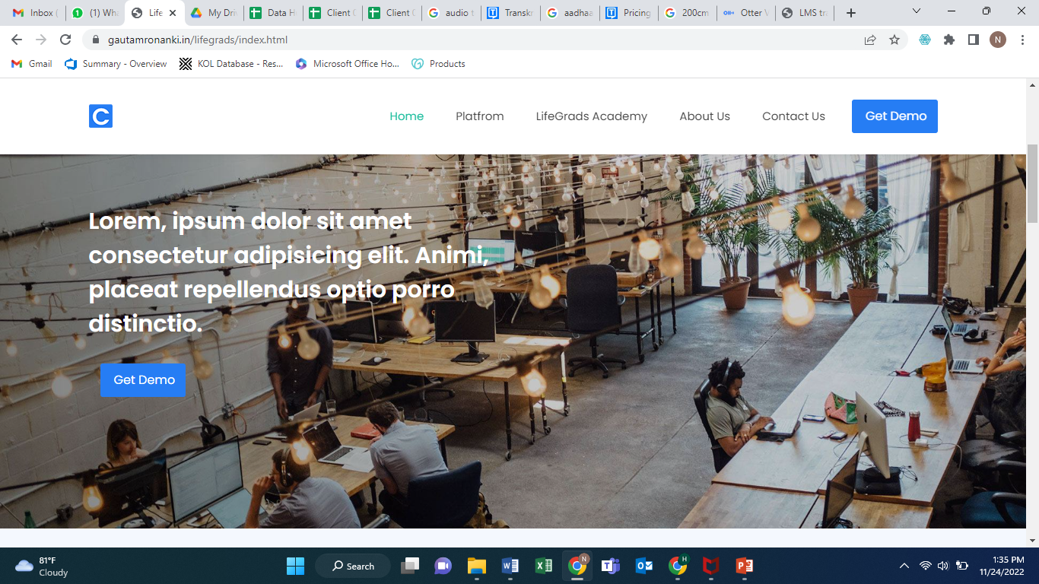
Make you learning process super-easy with reduced maintenance costs. With Lifegrads, get the customized LMS tool as per your end-users.

Slide 4
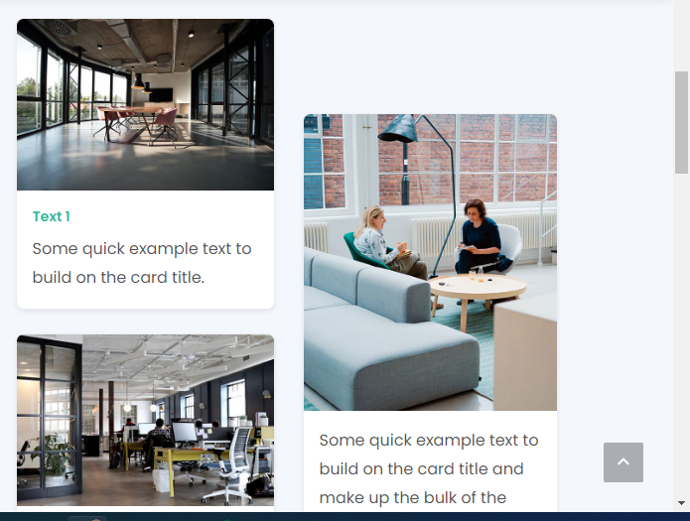
Text 1: Responsive Tool – Easy Access from any device.
Pic 1: https://www.freepik.com/free-photo/hands-working-digital-device-network-graphic-overlay_18421292.htm#query=lms&position=7&from_view=search&track=sph
Text 2: Learn when you want from anywhere in the world.
Pic 2: https://www.freepik.com/free-vector/education-technology-futuristic-background-vector-gradient-blue-digital-remix_16311844.htm#query=lms&position=34&from_view=search&track=sph
Text 3: The best medical education platform for your organization
Pic 3: https://www.freepik.com/premium-photo/doctor-laptop-work-study-medical-science-healthcare-health-education-online-via-internet-with-inner-anatomy-organs_34718462.htm#page=2&query=medical%20learning%20laptop&position=6&from_view=search&track=sph

Slide 5
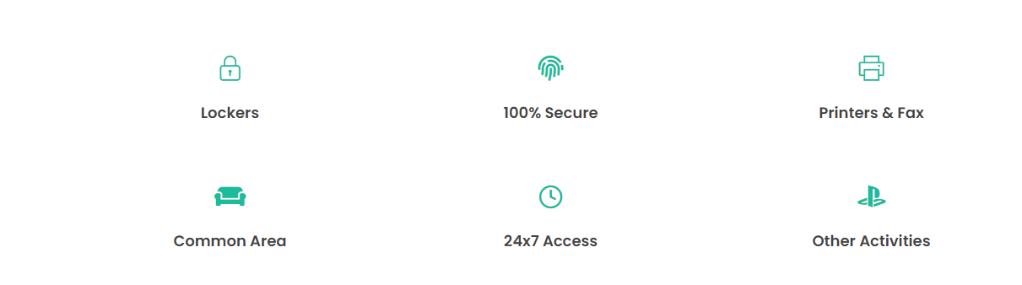
Data tracking
Flexible reporting and analysis
Mobile responsive
Automate notifications
24*7 access
Assessments and scoring

Slide 6
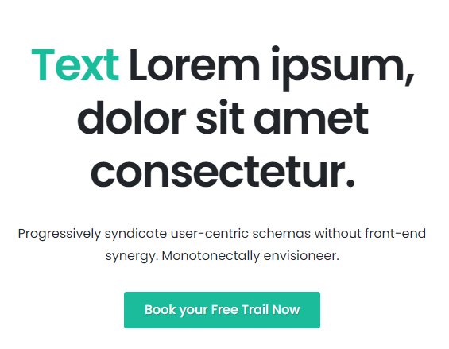
Building the most disruptive LMS tool for any medical organization.
Join with Lifegrads to build the new learning ways and improved features for your target audience.
Schedule your demo today

Slide 7
Platform
Create and Host Pic: https://www.freepik.com/premium-vector/it-professionals-are-creating-web-site-laptop-screen-website-development-web-application_31529729.htm#query=create%20and%20host&position=13&from_view=search&track=sph
Manage and Setup Pic1: https://www.freepik.com/free-photo/smiling-business-lady-working-with-colleagues_1022721.htm#query=manage&position=4&from_view=search&track=sph
Pic 2: https://www.freepik.com/free-photo/businesspeople-meeting-plan-analysis-graph-company-finance-strat_15873165.htm#query=manage&position=12&from_view=search&track=sph
Customize and localize pic: https://www.freepik.com/free-photo/collage-customer-experience-concept_25053721.htm#query=customize&position=6&from_view=search&track=sph
Deliver and setup pic1: https://www.freepik.com/free-photo/team-coworkers-comparing-source-codes-running-laptop-screen-computer-monitor-it-development-office-software-developers-collaborating-data-coding-group-project-while-sitting-desk_26367509.htm#query=setup&position=2&from_view=search&track=sph
Pic 2: https://www.freepik.com/free-vector/devops-team-abstract-concept-vector-illustration-software-development-team-member-agile-workflow-devops-team-model-it-teamwork-project-management-integrated-practice-abstract-metaphor_11668829.htm#query=deliver%20software&position=0&from_view=search&track=sph

Slide 8
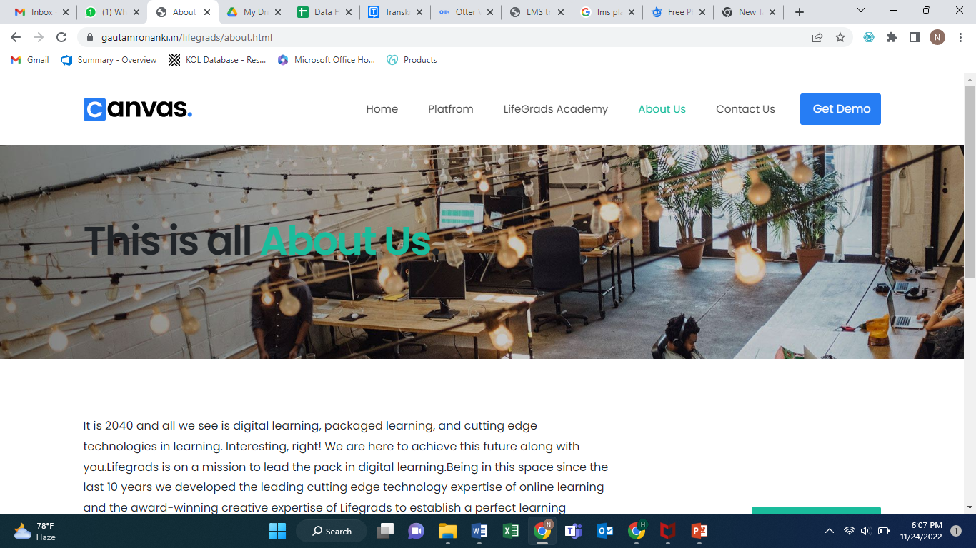
Pic: https://www.freepik.com/premium-photo/close-up-businessman-hand-holding-lms-learning-management-system-web-icon-lesson-online-education-course-application-study-e-learning-knowledge-everywhere-every-time_23167660.htm#page=4&query=lms&position=28&from_view=search&track=sph

